Slide 1
Activity/Programme Title
DATE
VENUE
TIME
NUMBER OF PARTICIPANT
ORGANIZER

Slide 2
OBJECTIVES (Refer Sustainable Development Goals (SDGs)
EXAMPLE:
1-NO POVERTY
2-ZERO HUNGER
11- SUSTAINABLE CITIES AND COMMUNITIES
17- PARTNERSHIPS FOR THE GOALS
TARGET GROUPS

Slide 3
TENTATIVE PROGRAMME
TIME | ACTIVITY
12.30 PM | Arrival of student at Regency Hotel Kuala Lumpur.
12.30 PM - 2.00 PM | Arrival VVIP and industries at Regency Hotel Kuala Lumpur. Registration of industries, lecturers, staffs and students.
2.00 PM – 3.00 PM | Opening ceremony, National Anthem Negaraku and Wawasan Setia Warga UiTM. Recitation of Prayers. Welcoming speech by Dean of Faculty of Plantation and Agrotechnology, Assoc. Prof Dr. Asmah Awal Speech by Industry Representative Opening Ceremony by Deputy Vice Chancellor of Students Affair, Prof. Dr. Azizan Abdullah. Token of Appreciation to Invited Industries.
3.00 PM | Hi-Tea ceremony. Inauguration Montage.
3.00 PM – 3.15PM | Student performance.
3.15 PM – 4.00 PM | Sharing Session with Industry.
4.00 PM – 4.30 PM | Student Award Ceremony. Award of Academic Performance. Award of Leadership Skills Award. Award of Entrepreneurship. Award of Sportsmanship. The Most Outstanding Award.
4.30 PM – 4.40 PM | Student Montage.
4.40 PM – 4.50 PM | Photography session.
5.00 PM | End of ceremony.

Slide 4
COST IMPLICATION
No. | Details | Total applied | Amount approved (RM) | Sponsorships/ contribution (RM) | Total (RM)
1. | Lunch | 13 000 | 13 000 | - | 13 000
2. | Banner | 100 | 100 | - | 100
3. | Flyers | 100 | 100 | - | 100
4. | Backdrop | 200 | 200 | - | 200
5. | Program requirements | 1 000 | 1 000 | - | 1 000
6. | Printing | 400 | 400 | - | 400
 | TOTAL |  |  |  | 14 800

Slide 5
BANNER/ BUNTING/ POSTER

Slide 6
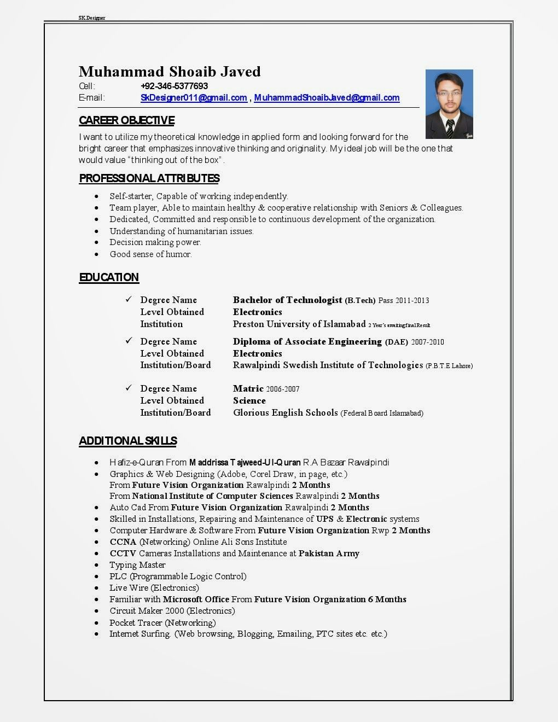
BIBLIOGRAPHY/ EVALUATOR/ FACILITATOR
CURRICULUM VITAE (CV)

